Slide 1
EUROPEAN UNION

Slide 2
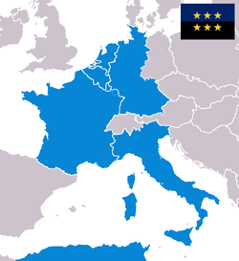
THE TREATY OF PARIS
French Foreign Minister Robert Schuman presented a plan for cooperation between European states, ‘The Schuman Declaration’. This plan led in April 1951 to the Treaty of Paris, which set up the European Coal and Steel Community.
He aim of this European Union was not only economic but also political because:
These two raw materials were the basis of the industry of these countries
The underlying political objetive was to strengthen the aliance between France and German (main enemies along the Second World War).
They tried to banish the spectre of another war: if production of steel was controlled, would be difficult made new weapons secrectly.
It included six countries:
Belgium, France, Italy, Luxembourg, the Netherlands and the Federal Republic of Germany (West Germany).

Slide 3
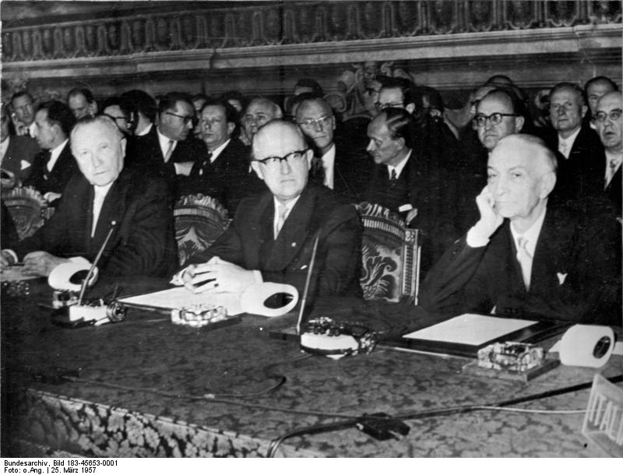
Countries of steel and coal union (Belgium, France, Italy, Luxembourg, the Netherlands and West Germany) signed the TREATY OF ROME (1957)

Slide 4
Measures of treaty of Rome (1957):
Common economic policies: the most important was the Common Agricultural Policy or CAP.
The CAP enacted a free marcket of agricultural products inside de EEC.
Avoiding competition between countries´ products, guarranteeing agricultural prices.
2. “The common market”: free movement of goods between its members: a country´s products can be sold in other member countries without customs duties. This creates a larger market for the products of European companies.
3. Community legislation: common lawsimplemented in all member states.

Slide 5
TO SUM UP: AFTER TREATY OF ROME

Slide 6
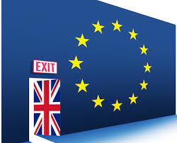
The "British problem"
The absence of the United Kingdom constituted the main political problem that the EEC had to face in its early years. The British government refused to participate for different reasons:
Its refusal to join a customs union
The fact that Britain was totally opposed to embarking on a project whose aim was to surrender th sovereignty of national states to supranational European institutions.
After negotiations to integrate Britain in the EEC broke down, Britain realized its mistake. Whereas the EEC witnessed a spectacular economic growth, Great Britain continued its downward trend in relation to the Continent.
Therefore, in August of 1961 the British Prime Minister requested the beginning of negotiations on accession to the EEC. However, after starting negotiations, the French leader, Charles De Gaulle, in 1963 vetoed British accession to the EEC. He was resolved to build up a Europe of the homelands that would become a third superpower between the USA and the USSR, and was suspicious of the Britain’s close bonds with Washington. In 1967, when British Labour prime minister, Harold Wilson, again requested to join the EEC, the French general once more banned the accession of the United Kingdom.

Slide 7
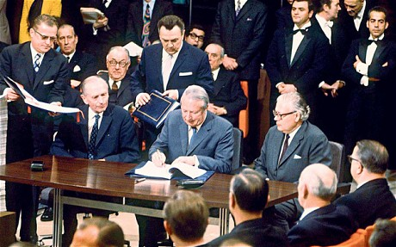
THE EUROPE OF NINE
Only the resignation of De Gaulle in 1969, for reasons of home affairs, opened up the possibility of British accession.
After overcoming the tough opposition of a significant section of the British public that claimed to maintain an anti-European stance, negotiations came to an end in 1972. Eventually the United Kingdom joined the EEC. Denmark and Ireland accompanied it. The Europe of the Nine was born.
Edward Heath, British prime minister signs the accesion to the EEC (1973)

Slide 8
The enlargement to the "Europe of the Twelve" (1973-1986)
The 1973 economic crisis put an end to a period of impressive economic growth that European countries had enjoyed for a long time. Unemployment, inflation and crisis of traditional industrial sectors characterized the economic landscape of the EEC in the second half of the 70es and early 80s. In spite of this situation, the process of enlargement proceeded.
These were the key advancements:
In 1979 the European Currency Unit (ECU), direct predecessor of the Euro, was born. It was the first significant step toward monetary union.
First elections to the European Parliament by direct universal suffrage were held in 1979.
The end of military dictatorships in Greece (1974), Portugal (1974) and Spain (Franco died in 1975) made possible the accession of these nations. Greece, in 1981, and Spain and Portugal, in 1986, became new members of the EEC. The Community was enlarged toward the Mediterranean Europe.

Slide 9
Felipe González, the president of the government signing the accession of Spain to ECC in 1982

Slide 10
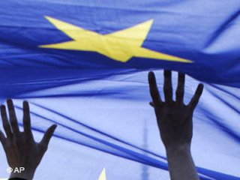
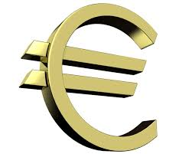
THE TREATY OF MAASTRICHT
The Treaty of the European Union (TEU), also known as Treaty of Maastricht for having been signed in that Dutch town, constitutes a turning point in the European integration process in some aspects:
The Treaty of Maastricht changed the official denomination of the EEC. Henceforth, it will be known as European Union.
Economic and monetary union: the introduction of an European currency, the Euro, was decided.
Free movement of persons and residence for EU citizens, as well as a Common Foreign and Security Policy.
New funds and policies of solidarity to help less developed regions or countries with a dificult economic situation.

Slide 11
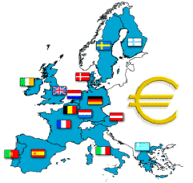
THE EUROPE OF THE FIFTEEN
On 1 January 1995, the fourth enlargement of the EU took place with the accession of Austria, Finland and Sweden. The Europe of the Fifteen was born. Norway was also admited to join EU, but Norwegian people rejected the accession to the EU. The NO to the European Union won in a referendum with 52.2% of the votes.

Slide 13
Increases the legislative authority of the European Parliament – The people can elect the parliamentarias, so, this give more power to european citizens.
Restricts the areas in which decisions must be unanimous. The decisions should be choosen and approved by all the countries,

